Slide 1
Serum Marker Physiology and Measurement
Jack Canick
Intensive Course on Screening for Down’s Syndrome
Wolfson Institute of Preventive Medicine
London
May 2013
Women & Infants’
BROWN

Slide 2
What is the basis of maternal serum screening for Down syndrome?
In Down syndrome pregnancy, certain substances, synthesized and secreted by the fetoplacental unit, are abnormal when measured in maternal serum.

Slide 3
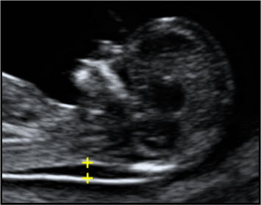
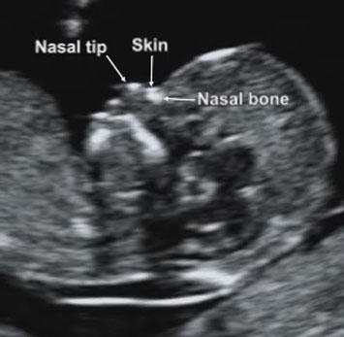
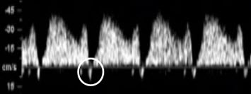
Prenatal markers of the Down syndrome phenotype:
so-called “Surrogate Markers”
Maternal Serum:
PAPP-A low
AFP low
uE3 low
β-hCG elevated
inhibin A elevated
Fetal ultrasound:
Nuchal Translucency increased
Nasal Bone absent/small
Nuchal fold thickness larger
Femur/Humerus shorter
Echogenic cardiac focus present
Ductus venosus doppler reversed a-wave
Nuchal Translucency
Nasal Bone
Ductus venosus doppler
www.fetalmedicine.com/fmf

Slide 4
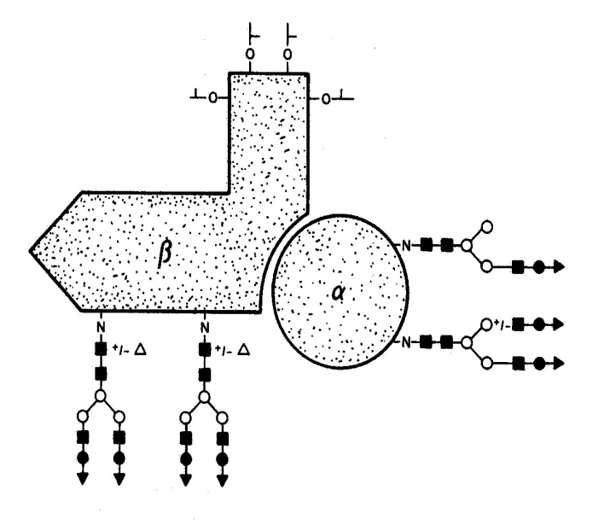
What are these substances?
All but one are glycoproteins.
A glycoprotein is a protein with chains of carbohydrates attached (usually adding 10-40% to the molecular weight).
Proteins that have carbohydrate chains added to them are almost always targeted for secretion out of the cell into the vascular system.
Glycoproteins are usually more soluble and have longer half-lives than proteins (they remain in the vascular system for a longer time).
Example of a gylcoprotein: hCG
In: Blithe DL et al,
Trends Endocrinol
1:394-8, 1990

Slide 5
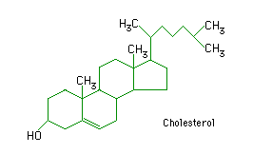
The seventh marker (uE3) is a steroid hormone.
Steroid hormones are made from cholesterol, the major steroid of the body.
Steroids are lipid-like, fused ring structures made up entirely of carbon and hydrogen, with a small number of oxygen groups attached.
Steroid hormones are secreted by diffusion from their sites of synthesis, and can pass in and out of all cells in the body.

Slide 6
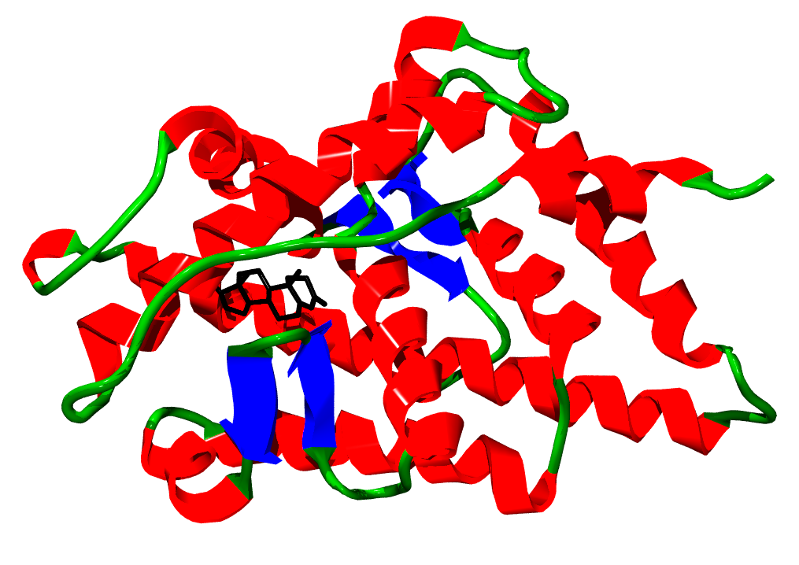
Relative size of a steroid and protein:
Testosterone bound to the human androgen receptor
en.wikipedia.org/wiki/Anabolic_steroid

Slide 7
Molecular weights of the markers
marker | Mol Wt (kDa) | relative radius of sphere
uE3 | 0.3 | 1.0
inhibin-A | 30 | 4.7
hCG | 40 | 5.2
AFP | 70 | 6.1
PAPP-A | 700 | 13.2
PAPP-A (700K)
AFP (70K)
hCG (40K)
uE3 (0.3K)
inhibin-A (30K)

Slide 8
If PAPP-A is the world’s land mass,
uE3 is Great Britain.

Slide 9
alpha-fetoprotein (AFP)
a glycoprotein
structurally and functionally similar to albumin
antigenically distinct from albumin
an ‘oncofetal antigen’
produced by the yolk sac and fetal liver
the most abundant protein in fetal circulation
half-life in blood approx. 7 days

Slide 10
Aside: Why are maternal serum AFP levels elevated in open fetal defects?
Simple biological explanation:
A strong concentration gradient
Fetal circulation
Amniotic fluid
Maternal serum
open
defect
AFP concentrations in the fluid compartments of pregnancy.
Seppala M. (1975) Ann NY Acad Sci 259:59.

Slide 11
alpha-fetoprotein (AFP)
Role in pregnancy:
Does not appear to be required for normal fetal function or development.
Examples of absent AFP and normal obstetrical outcome. [Greenberg F et al, Am J Obstet Gynecol 1992;167:509-11; Sharony R et al, Eur J Hum Genet 2004;12:871-4]
AFP, like albumin, can bind fatty acids, and other hydrophobic chemicals.

Slide 12
unconjugated estriol (uE3)
a steroid hormone
the major estrogen of pregnancy
requires the fetal adrenal, fetal liver and placenta for its synthesis
Turns over very rapidly in blood (t_{½} approx. 20-30 min.)
Es-triol = 3 hydroxy groups
Called ‘unconjugated’ because it is the free or nascent form, as it is secreted by the placenta.

Slide 13
MOTHER PLACENTA FETUS
Cholesterol
(LDL)
Progesterone
Cholesterol
(LDL)
ADRENAL
Cholesterol
(LDL)
secretion
uE3
uE3
DHEA sulfate
Conjugation to
E-sulfates
and
E-glucuronides
followed by
excretion
LIVER
DHEA sulfate
16α-OHDHEAS
16α-OHDHEAS

Slide 14
estriol (uE3)
Role in pregnancy:
Weak estrogen.
Softening of the cervix prior to parturition?
Contributes to preparation of breast for lactation?

Slide 15
human chorionic gonadotropin
(hCG)
alpha-beta subunit glycoprotein hormone
molecular weight approx. 38,000 daltons
synthesized in placenta syncytiotrophoblast
half-life in blood approx. 1-2 days

Slide 16
free alpha and beta
subunits of hCG
beta
alpha
no known biological function as individual subunits
molecular weight of alpha subunit approx. 15,000 daltons
molecular weight of beta subunit approx. 23,000 daltons
secreted by placenta as free subunits; produced by dissociation of intact hCG in blood

Slide 17
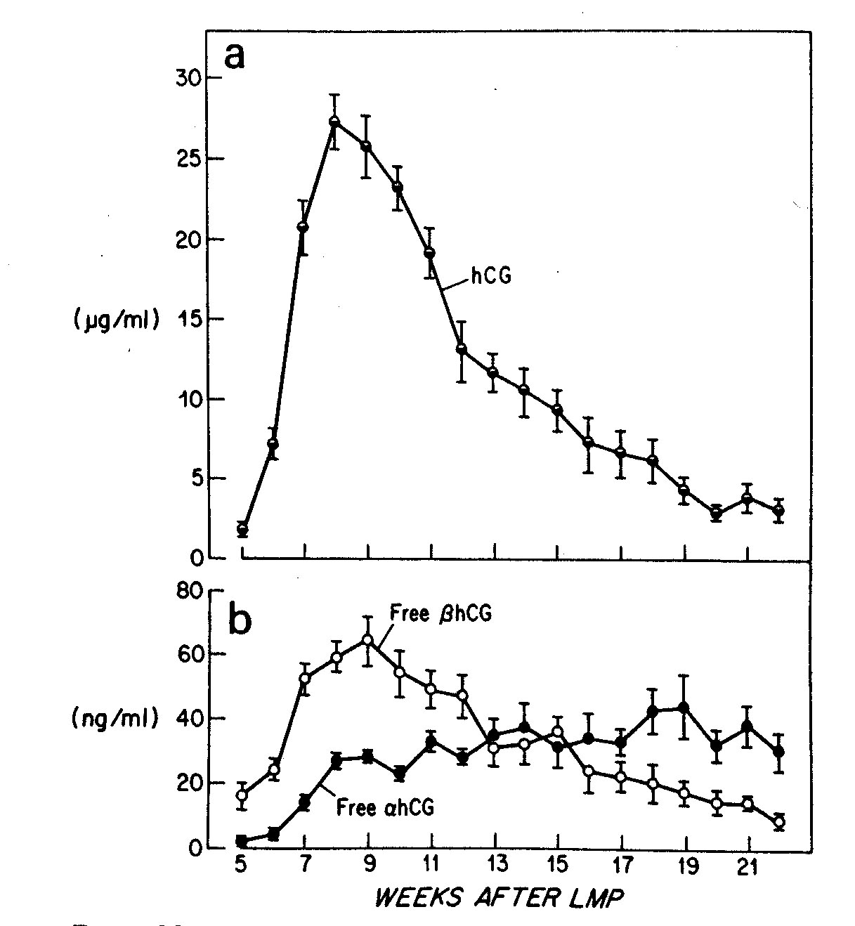
Pattern of hCG and its Free Subunits in Maternal Serum During the First Half of Pregnancy
M Ozturk et al, Endocrinology 1987; 120:549-558.

Slide 18
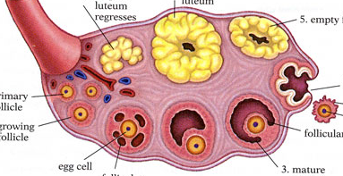
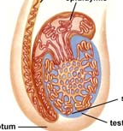
During 1st trimester, is required for maintaining progesterone synthesis by the mother’s corpus luteum.
hCG
progesterone
When a male fetus is present, stimulates the fetal testes to make testosterone, required for male phenotypic development.
hCG: Role in
Pregnancy
testosterone

Slide 19
alpha
inhibin A
inhibin A
beta A
beta B
inhibin B
alpha-beta subunit glycoprotein hormone
inhibin-A = alpha subunit + beta_{A} subunit
member of the TGFβ gene family (also includes inhibin B, activins, anti-Mullerian hormone)
molecular weight approx. 32,000 daltons
Inhibins are synthesized in ovary (inhA and B), testis (inhB only), and placenta

Slide 20
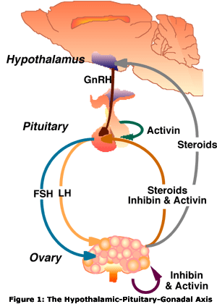
inhibin A (inhA)
Role in pregnancy:
Inhibits FSH secretion at the level of the pituitary, which contributes to preventing ovulation during pregnancy.
Inhibin A
Placenta

Slide 21
PAPP-A: pregnancy-associated plasma protein-A
very high mol. wt. glycoprotein (approx. 700,000 Da)
made up of 4 subunits:
2 PAPP-A subunits (approx. 250,000 Da each)
2 pro-MBP subunits (approx. 50-90 Da each)
serum levels increase throughout pregnancy
PAPP-A
S
S
Pro-MBP
S
S
Pro-MBP
S
S
PAPP-A

Slide 22
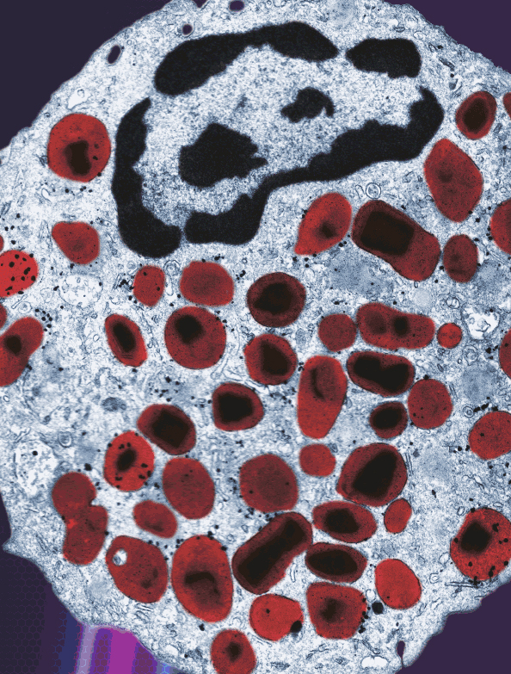
PAPP-A: pregnancy-associated plasma protein-A
pro-MBP is the inactive precursor of Major Basic Protein (MBP).
MBP is found in the eosinophil crystalloid body; it has a very basic pI; it is cytotoxic; it functions in inflammatory response.
PAPP-A itself is an insulin-like growth factor binding protein-4 (IGFBP-4) protease.
It may facilitate IGF action at the maternal-placental interface (Sun et al, J Clin Endocrinol Metab 2002;87:5235).
In other words, it may be involved in the regulation of fetoplacental growth.
www.nature.com/labinvest/journal/v89/n7/

Slide 23
PAPP-A is an IGFBP protease:
IGFBP proteases release circulating IGF to interact with its receptors on target cells and stimulate growth
IGF
target cell
GROWTH

Slide 24
Median Levels of Serum Markers during the Screening Period in Unaffected Pregnancies
AFP
uE3
hCG or free β-hCG
15 20
15 20
10 20
GA (wks)
GA (wks)
GA (wks)
inhA
PAPP-A
15 20
10 14
GA (wks)
GA (wks)

Slide 25
Measurement of Serum Markers
All current analytes are measured by immunoassay.
Requires specific antibodies used as tools to pull out a particular analyte (the antigen).
If a large molecule (i.e., a protein) is to be measured, it is most common to use a two-site immunometric assay.
If a small molecule (i.e., a steroid) is to be measured, it is most common to use a single-site competitive immunoassay.
In either case, the signaling method can be radioactive, colorimetric, fluorometric, chemiluminescent (or others).

Slide 26
Two-Site Immunometric Assay (for large molecules)
Y
Y
Antibody 1
(capture Ab)
Protein X
Antibody 2
(signal Ab)
Y
Y
Y
Y
this is measured

Slide 27
Non-competitive
Immunometric 2-site assay:
AFP Standard Curve
100000
10000
1000
36 ng/ml
Fluorescence
100
10
1
0
1
5
20
100
500
AFP concentration (ng/ml)

Slide 28
Competitive Immunoassay (for small molecules)
Y
antigen
Steroid X
limited amount
of antibody
(capture Ab)
signal antigen
(signal Ab)
Y
Y
+
this is measured

Slide 29
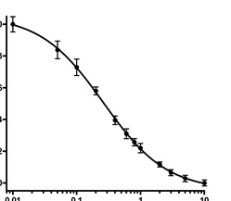
Competitive immunoassay:
Standard Curve
B/ B₀
0.1 0.2 0.4 0.6 0.8 1.0
3.6 ng/ml
0.1 1 10 100
uE3 (ng/ml)

Slide 30
Measurement of Serum Markers: Issues
Most clinical laboratories use commercial assays.
For AFP, uE3, hCG, free β-hCG, and PAPP-A, there are choices in selecting a commercial assay.
For inhibin A, only one manufacturer, Beckman Coulter, offers the assay, in both manual and automated formats. The antibody pair is the same for both, but the sample treatment is different. Both have been validated to work in serum screening.
In prenatal screening, the accuracy of the individual assay is less important than the precision, since analyte values are normalized to a common unit, the multiple of the median (MoM).

Slide 31
Physiology and Measurement of the
Serum Screening Markers
Coming Soon:
Physiology and Measurement of
Plasma DNA

Slide 32
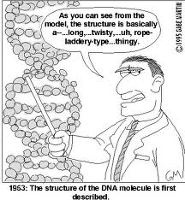
As you can see from the
model, the structure is basically
a …long, …twisty, …uh, rope-
laddery-type…thingy.
The Biology of DNA

